Slide 1
UDDI

Slide 2
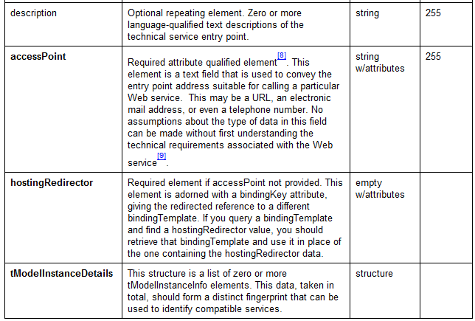
bindingTemplate…

Slide 3
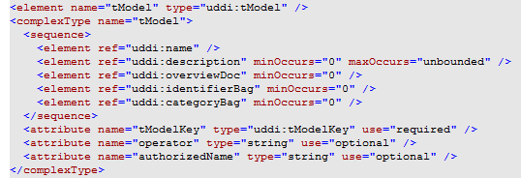
4.tModel

Slide 4
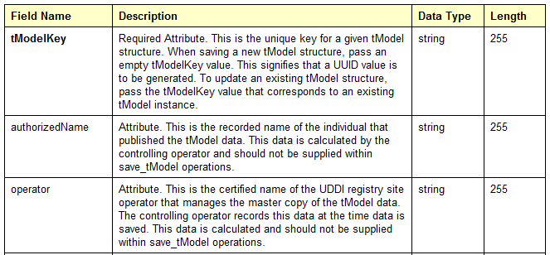
tModel…

Slide 5
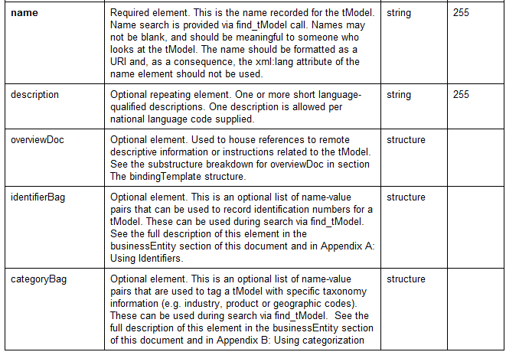
tModel…

Slide 6
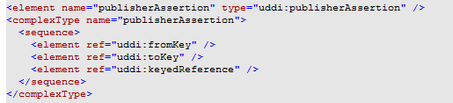
5.publisherAssertion

Slide 7
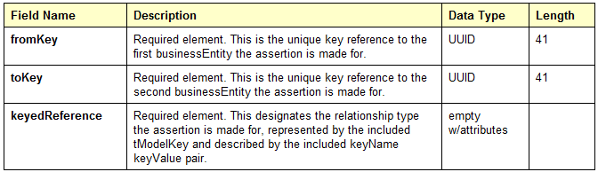
publisherAssertion…

Slide 8
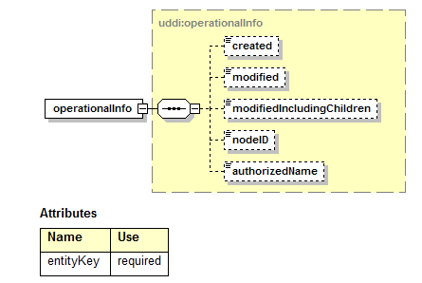
6. operationalInfo

Slide 9
UDDIKeys
UDDI Registries MUST use keys that conform to the grammar.
A derived key has the form uddikey “:” KSS
KSS – Key Specific String is composed of upper and lower case characters, numbers and other symbols permitted in a URI.

Slide 10
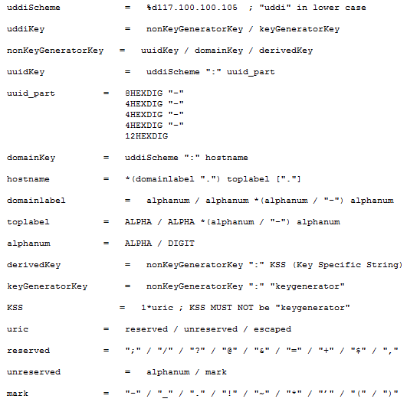
Key Syntax

Slide 11
Example Keys…
Legal domain key uddi:tempuri.com
Legal uudikey
  uddi:4CD7E4BC-648B-426D-9936-443EAAC8AE23
Legal derivedkey
  uddi:AC104DCC-D623-452F-88A7-F8ACD94D9B2B:xyzzy
  uddi:tempuri.com:fish:buyingservice

